Slide 1

Hive Streaming
Boost Enterprise Video Streaming with Machine Learning
Stefanos Antaris
Research Engineer
Hive Streaming AB
KTH Industrial PhD
Big Data Summer School 2019

Slide 2






Video is everywhere
Video Streaming Solutions
Video-on-Demand (VoD)
Youtube
1.57 billion active users monthly
300 hours/minute uploaded content
Netflix
140 million hours/day watched
HBO
800K paying subscribers
Live streaming
Youtube live
HBO GO
Facebook Live

Slide 3



Problems?

Slide 4
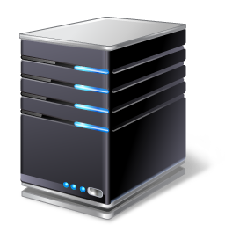



Public video streaming
Architecture
Content distributed on different CDNs
~1 viewer per gateway
Streaming Problems
CDN scalability issues
Telecommunication provider bottleneck
CDN EU
CDN ASIA

Slide 5
The challenge of enterprise video streaming
The future of enterprise communication is high quality video
Corporate networks can’t handle the load
Existing solutions require hardware maintenance costs and provide low quality

Slide 6
Enterprise vs Public video streaming
Public-facing model
Enterprise model
CDN EU
CDN ASIA
CDN EU
CDN ASIA

Slide 7
About Hive Streaming
Peer based streaming technology for enterprise networks
Offloads enterprise networks and servers up to 99%
Simple setup, minimal maintenance
Advanced analytics tools

Slide 8

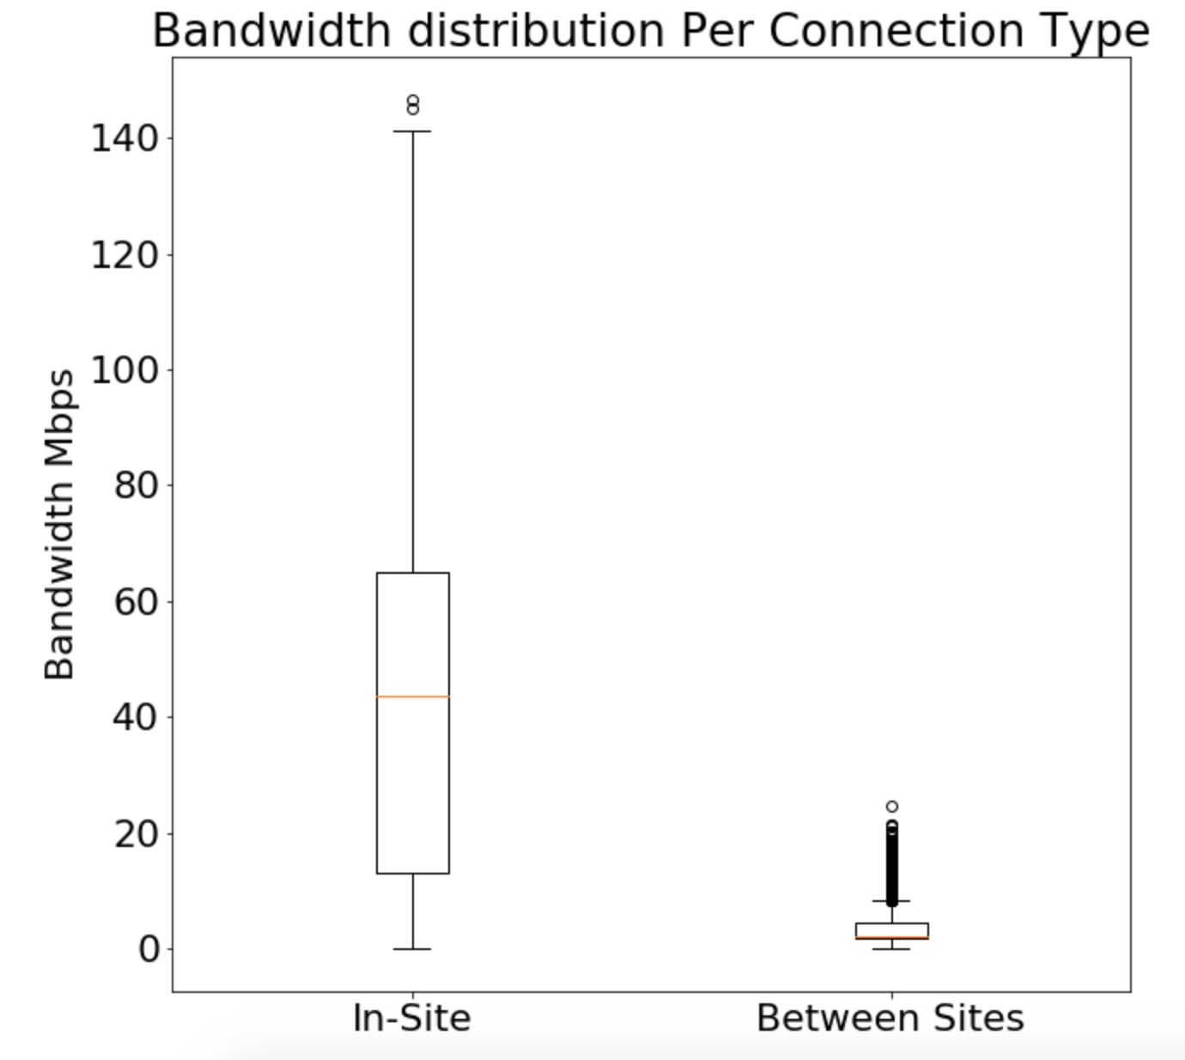
How does Hive work?
Why P2P?
More bandwidth inside the office
Peer-Assisted Video Streaming
One stream per office
Promote P2P within office
Control P2P between offices
Fallback to CDN iff P2P fails
Results
Less requests to CDN
No network congestion
CDN EU
Hive Tracker
5 Mb/s
Office 1
Office 2
100 Mb/s
100 Mb/s

Slide 9
Hive Operations
Labs
Client
Integration
Platform
Tools

Slide 10
Hive Clients
 | Hive Agent | Hive WebRTC
Programming language | Java | Typescript (Javascript)
Deployment | Agent installed as a service | No installation Runs on browser
Compatibility | Windows Mac OS | All OSs WebRTC compatible browsers
Generic Peer Discovery | Tracker | Tracker
Lan Peer Discovery | UDP Broadcast | NO

Slide 11
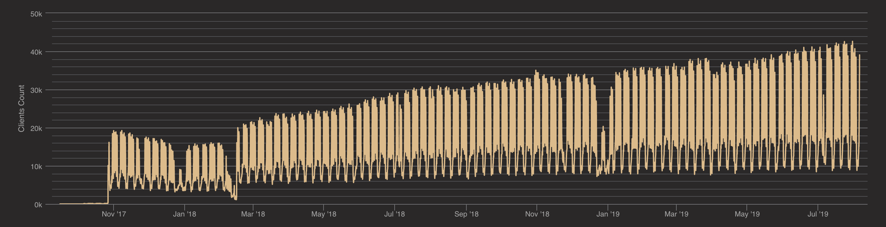
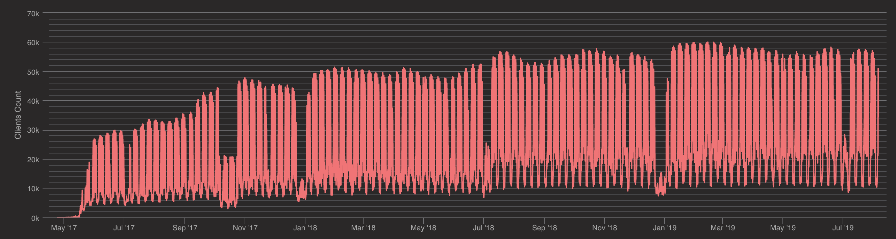
Challenge 1 – Deployment Monitoring

Slide 12
Challenge 1 – Deployment Monitoring
Detect anomalies
User-defined thresholds
Statistic thresholds
What threshold?
Lag delay?

Slide 13
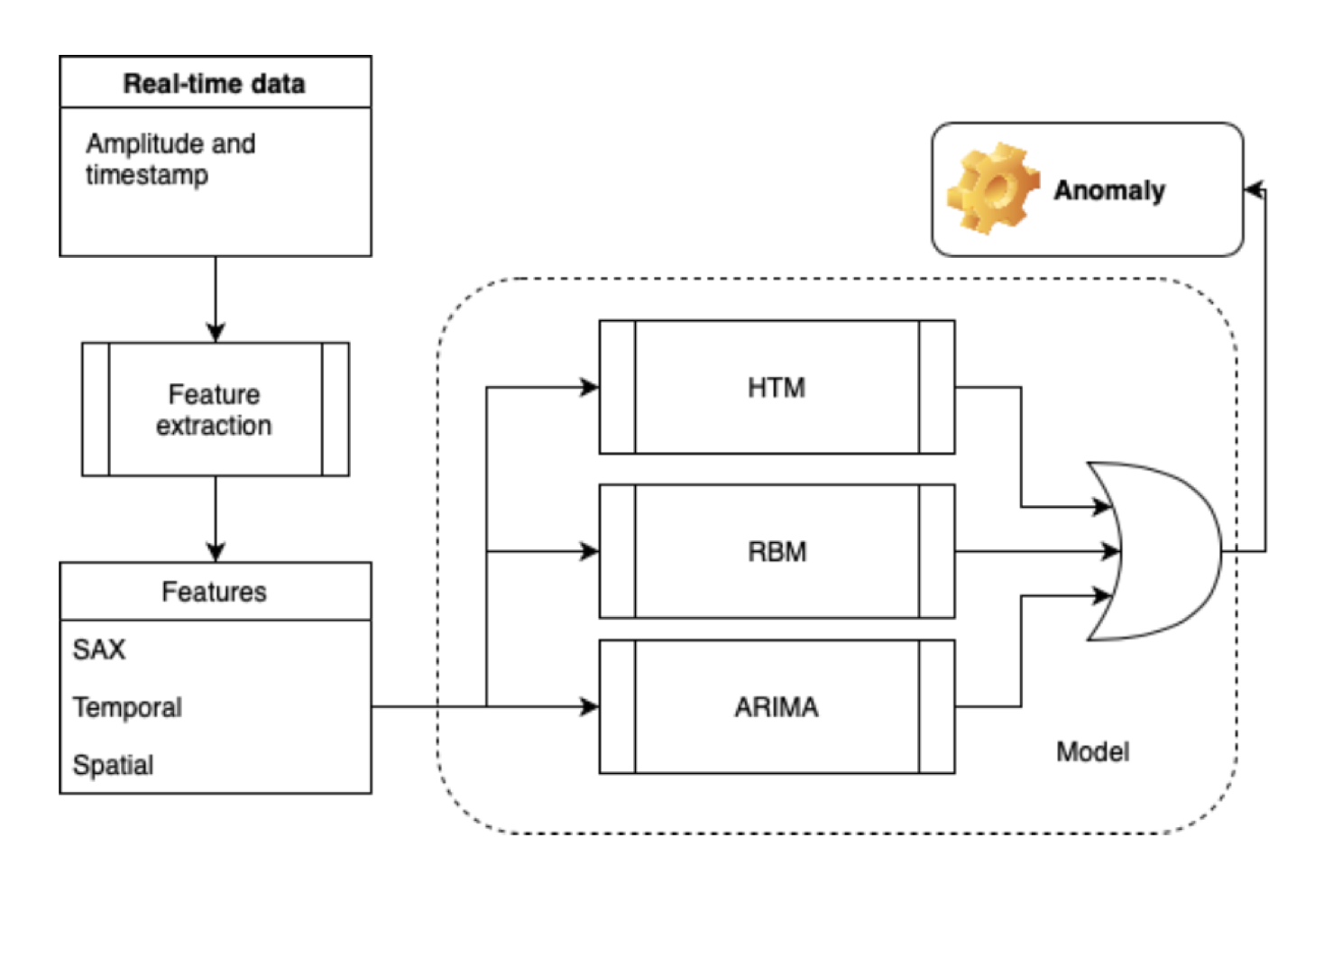
Challenge 1 – Deployment Monitoring

Slide 14
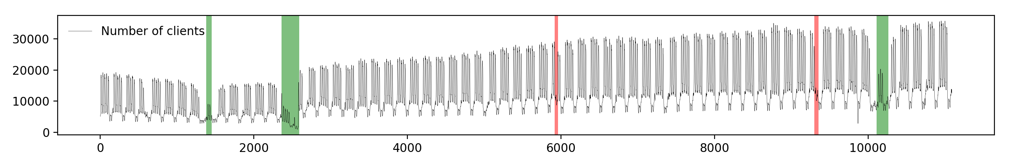
Challenge 1 – Deployment Monitoring

Slide 15
Challenge 2 – P2P Locality
 | Hive Agent | Hive WebRTC
Programming language | Java | Typescript (Javascript)
Deployment | Agent installed as a service | No installation Runs on browser
Compatibility | Windows Mac OS | All OSs WebRTC compatible browsers
Generic Peer Discovery | Tracker | Tracker
Lan Peer Discovery | UDP Broadcast | NO

Slide 16
Why locality is important?
Higher probability to detect peers in the same office
Lower network traffic between offices
Lower P2P latency
Less CDN requests
Lower probability to congest the network
CDN EU
Hive Tracker
10 Mb/s
Office 1
Office 2
1Gb/s
1Gb/s

Slide 17

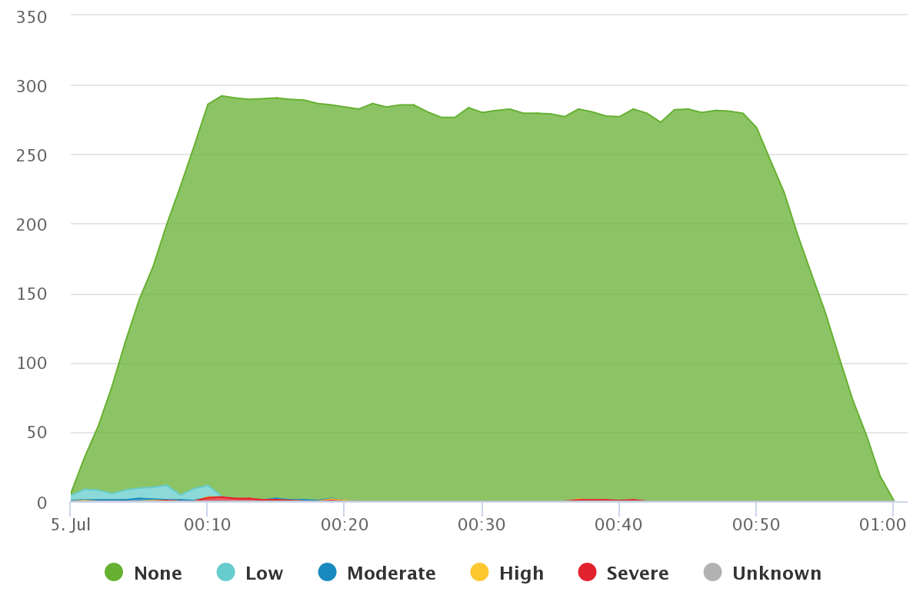
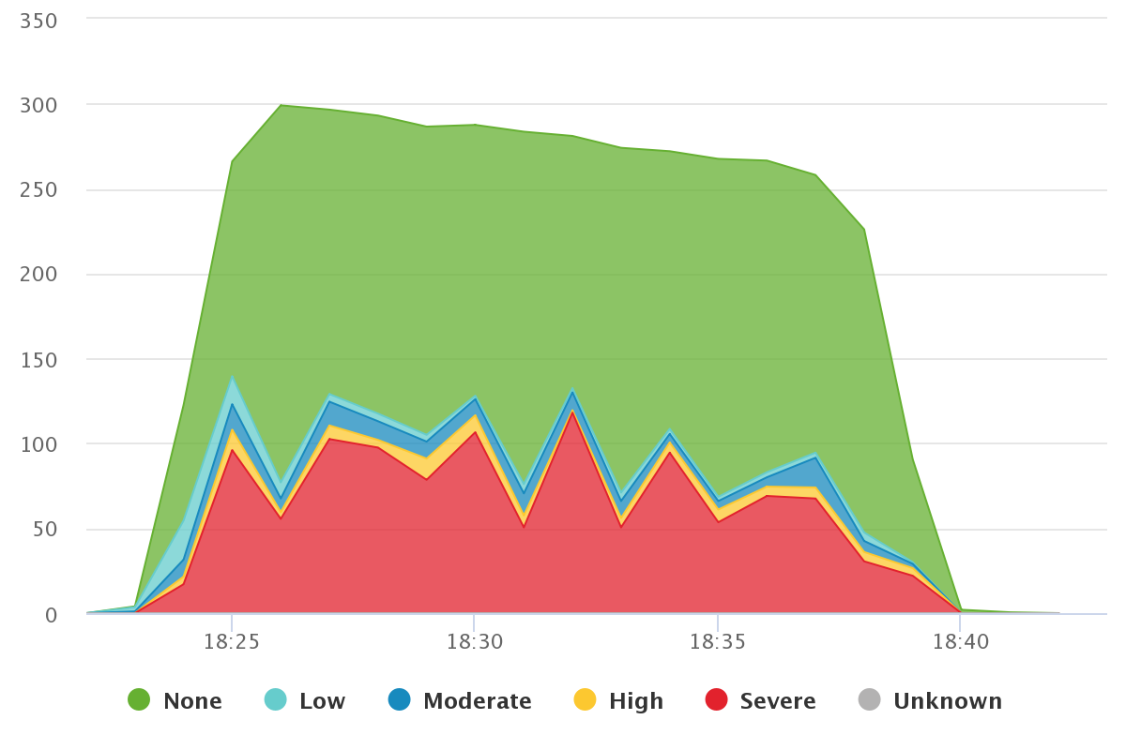
Why locality is important?
How to detect the other local peers?
Suffer to see the video

Slide 18
Fixing Locality Approach 1

Slide 19
Combine the Public/Private IP
Why not use public/private ip?
Same public ip means same building?
Also similar private ip means same office?
75.142.65.28
157.224.12.67
10 Mb/s
Office 1
Office 2
1Gb/s
1Gb/s
192.168.XX.XX
192.168.XX.XX

Slide 20
Combine the Public/Private IP
Why not use public/private ip?
Same public ip means same building?
Also similar private ip means same office?
What about VPNs?
75.142.65.28
Office 1
Office 2
France
Sweden
192.168.XX.XX
192.168.XX.XX

Slide 21
Combine the Public/Private IP
Why not use public/private ip?
Same public ip means same building?
Also similar private ip means same office?
Can we collect private IPs?
Chrome in A/B testing mode
“We have strategic initiatives going on like internet first who will not help in identifying subnets, in fact we will have overlapping IP ranges in multiple offices around the world and the users will only be facing the internet.“
75.142.65.28
157.224.12.67
10 Mb/s
Office 1
Office 2
1Gb/s
1Gb/s
192.168.XX.XX
192.168.XX.XX

Slide 22
Fixing Locality Approach 2

Slide 23
Random Walks
Remember why P2P?
More bandwidth inside the office

Slide 24
Random Walks
Connect and evaluate
Random walks
Drop connections with low throughput
10 Mb/s
Office 1
Office 2
1Gb/s
1Gb/s

Slide 25
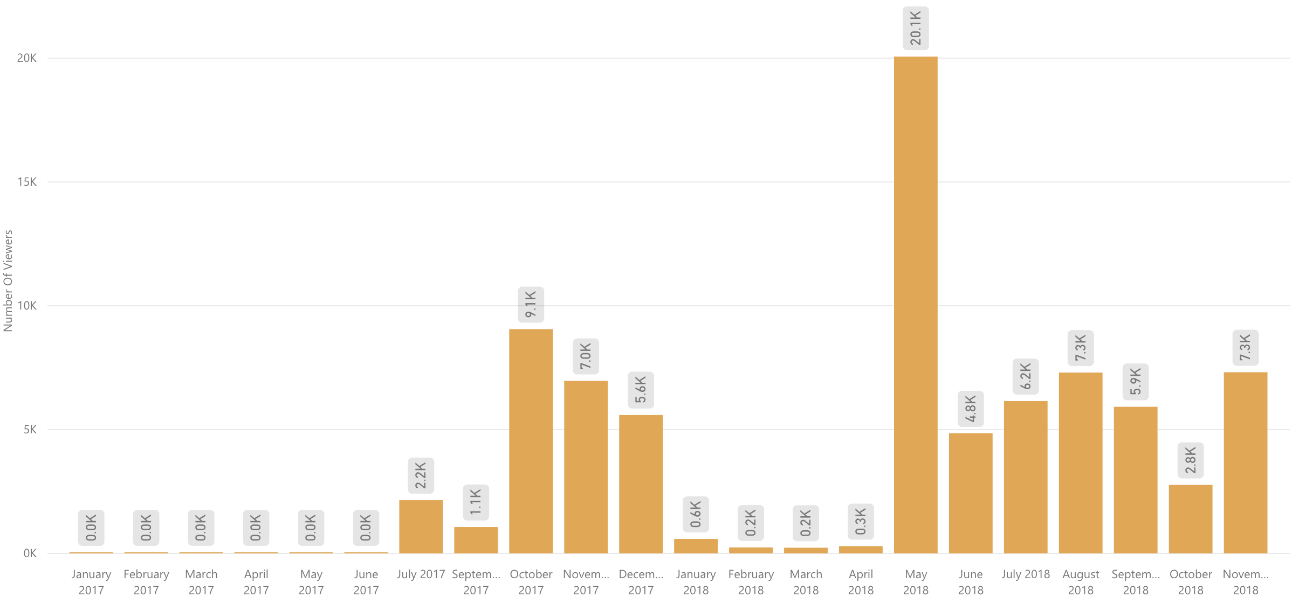
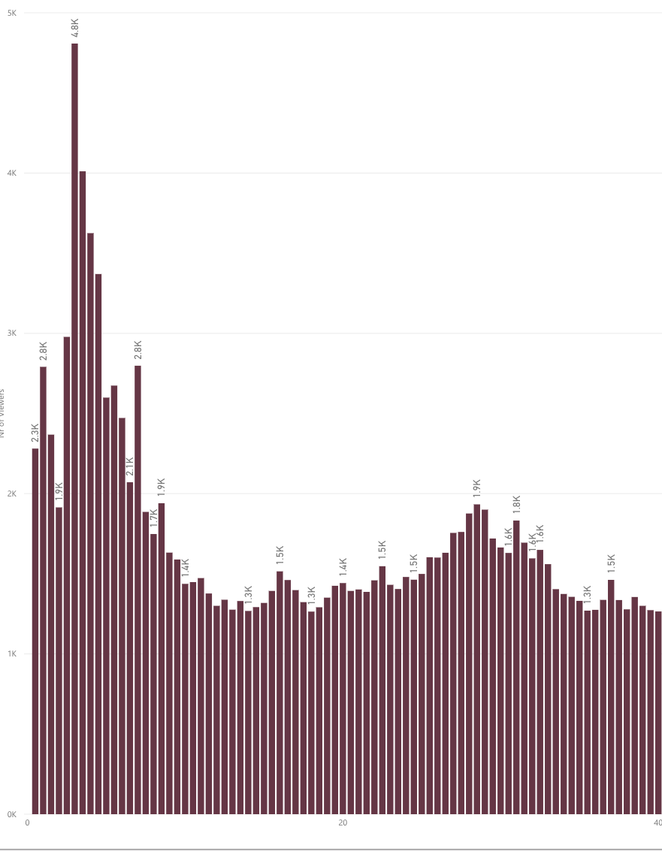
Random Walks
Not so much time for random walks
P2P connection time : 100ms < t < 3 secs
Small offices
Probability to find local peers : ~1%
Probability to congest the network : > 50%
20K viewers
Most viewers watch for 5 minutes
200 viewers

Slide 26
Fixing Locality Approach 3

Slide 27
Unsupervised Graph Clustering
Each peer periodically sends telemetry data
Quality of Experience (QoE)
CDN Bandwidth measurements
P2P measurements
Can we exploit these data?
Cluster local peers in groups
Bias the random walks

Slide 28
Unsupervised Graph Clustering
Collect data from previous events
Analyze each customer independent
Construct a graph
Each edge represents an existing connection
Edge weight
W_{ij} = throughput / threshold
Apply Label Propagation
Cluster peers based on their edge weights

Slide 29
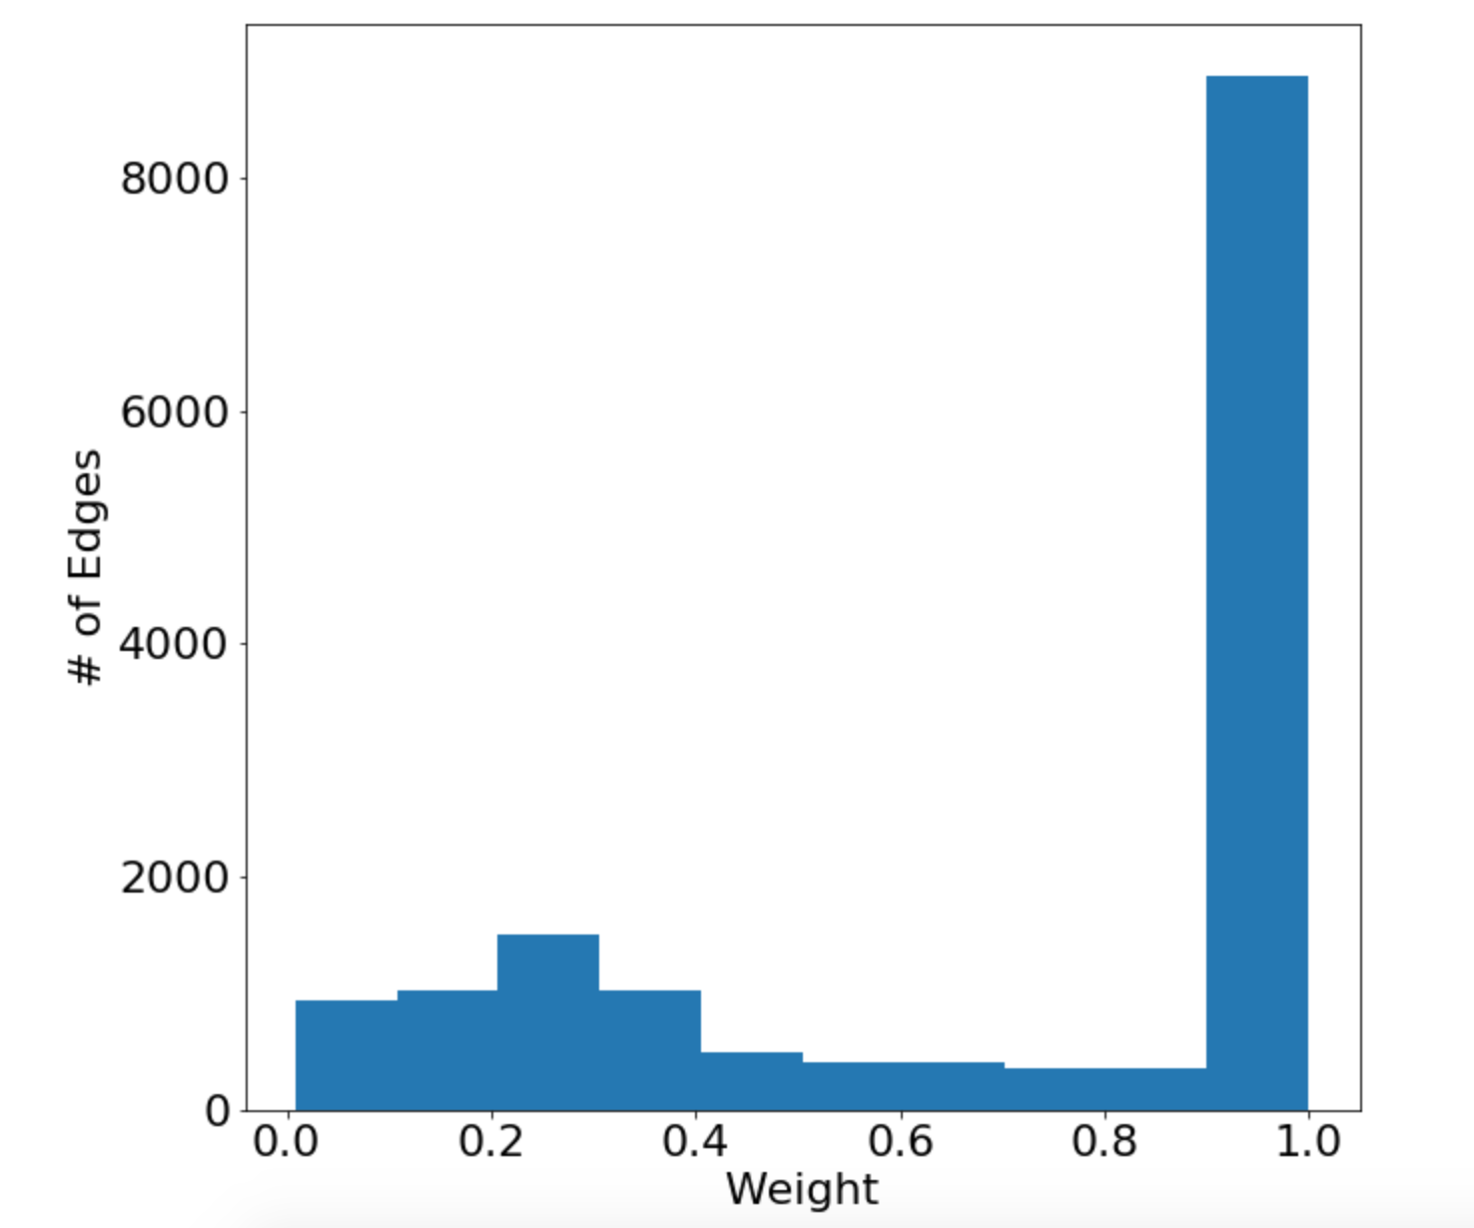
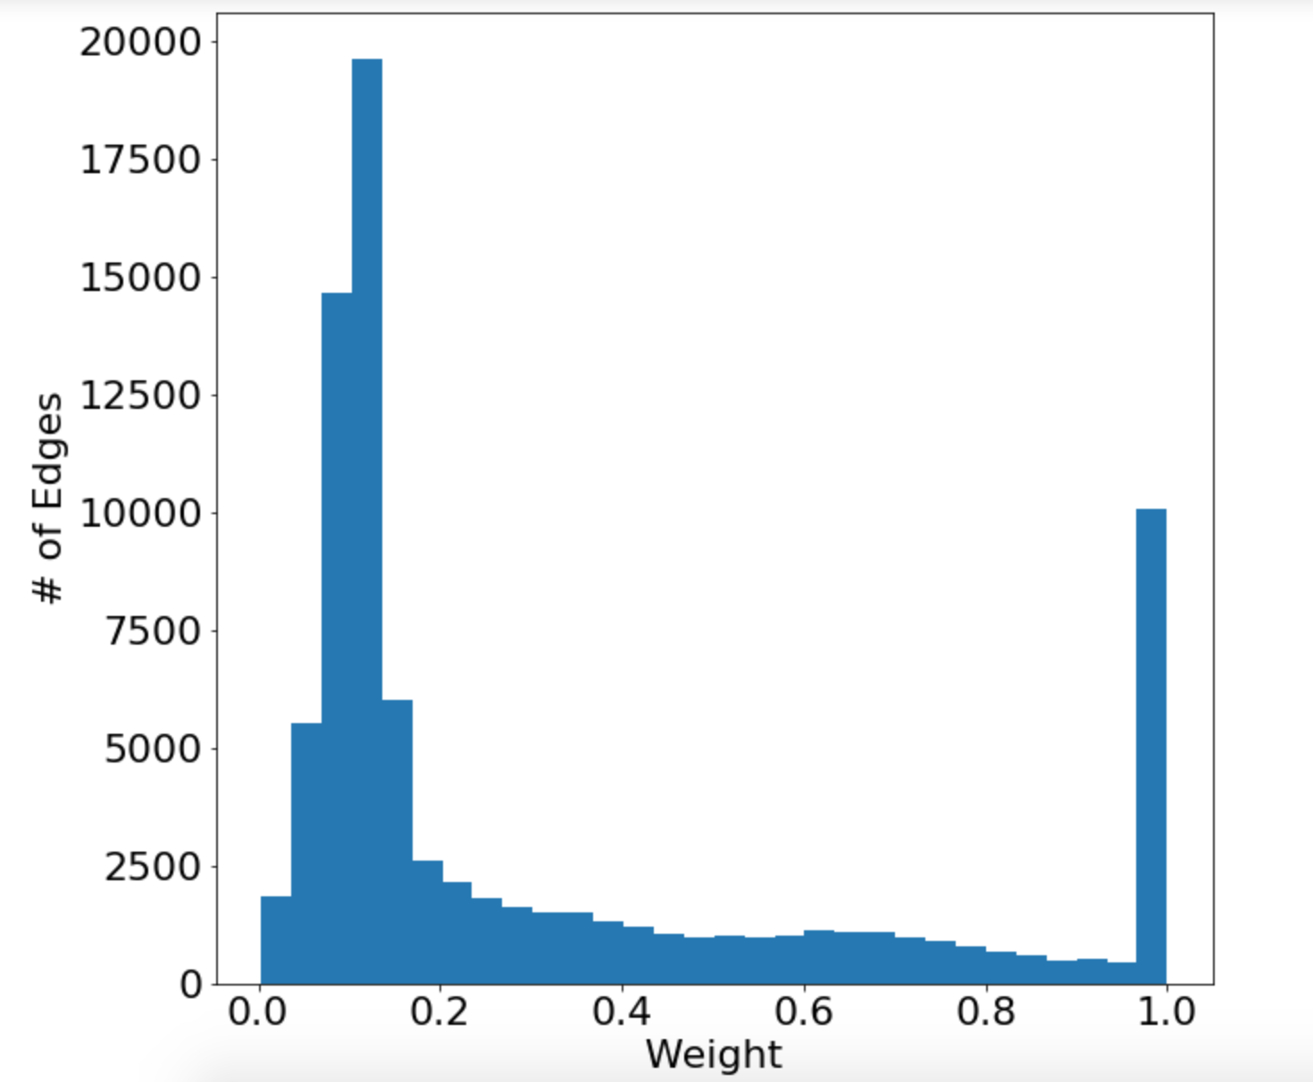
Unsupervised Graph Clustering
Adjacency matrix is 97% sparse

Slide 30
Fixing Locality Approach 4

Slide 31
Predicting Local Edges
Step 1
Collect Data
Previous live events
Silent tests
Clean data
Remove outliers
Remove duplicates
Construct the graph
Undirected
Weighted
Broadcast Information to Tracker
Step 2
Step 3
Predict Edges
Validate Graph
Network Embeddings
Unsupervised Graph Clustering

Slide 32
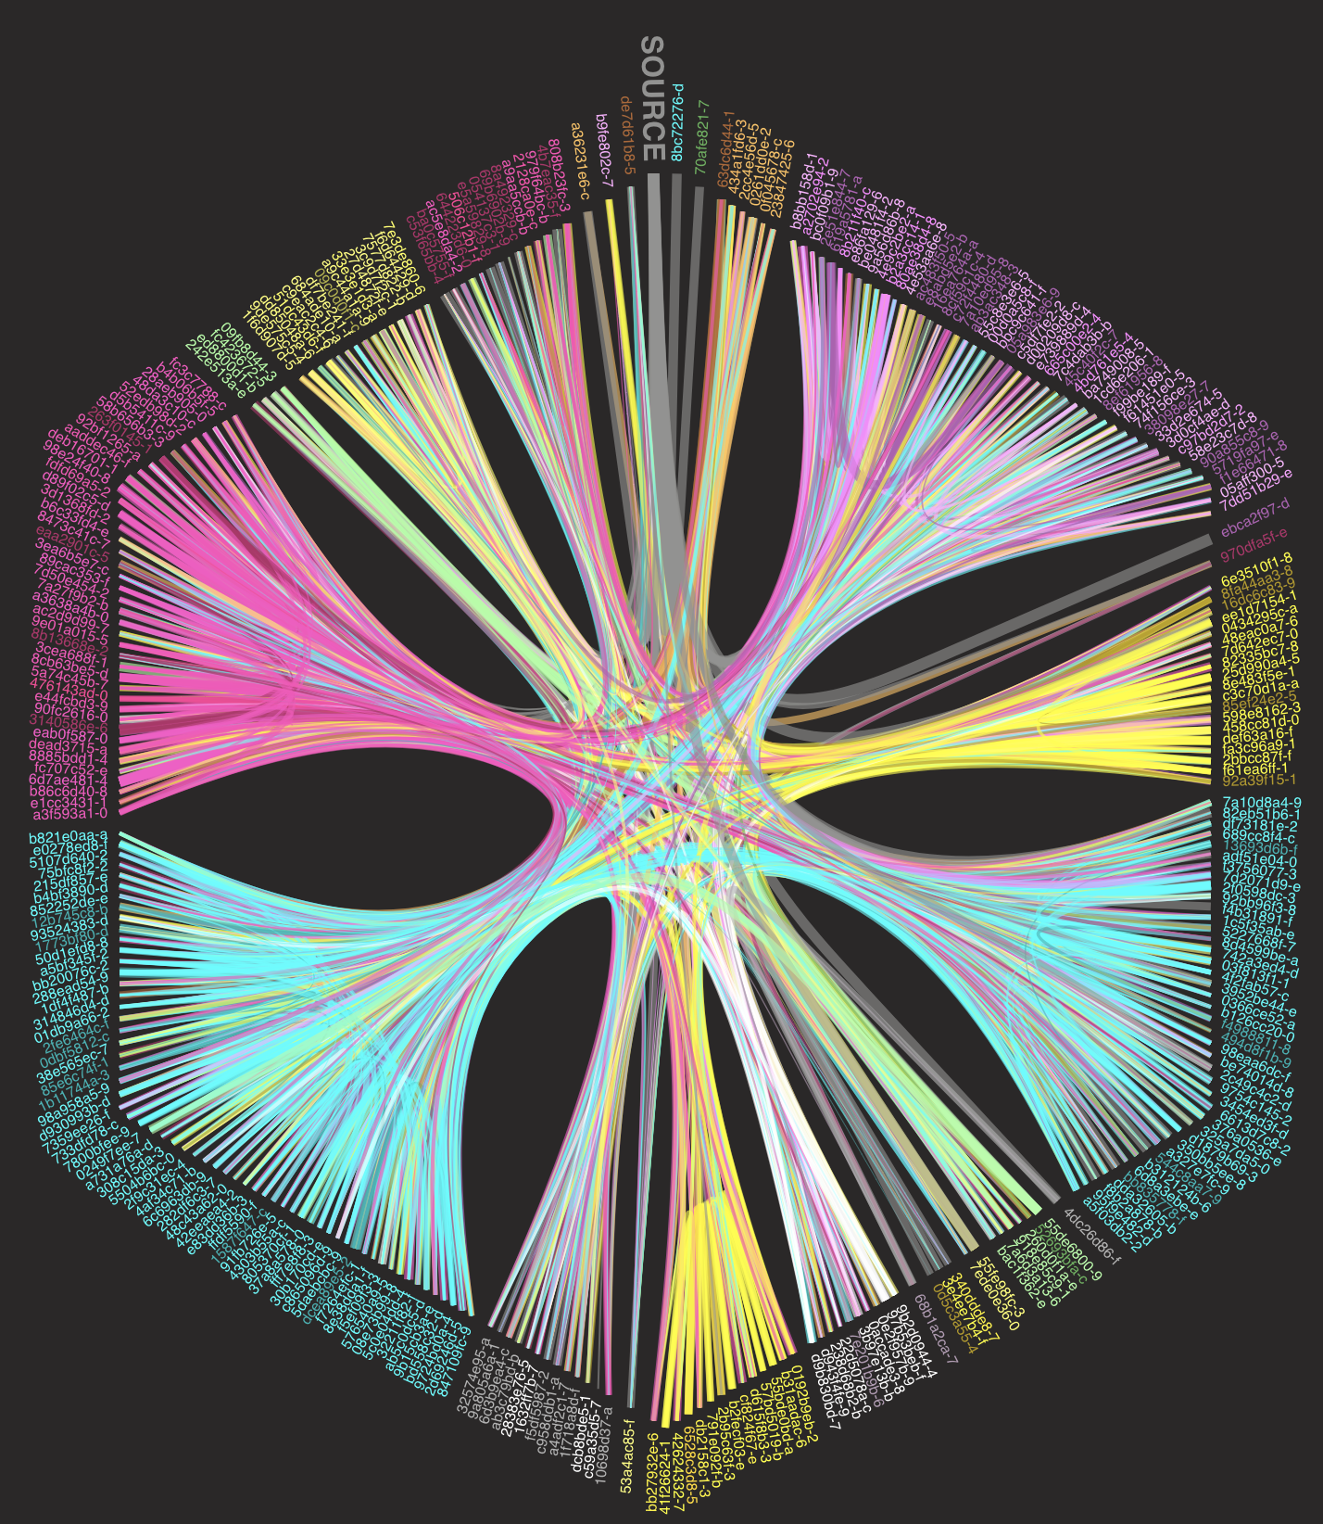
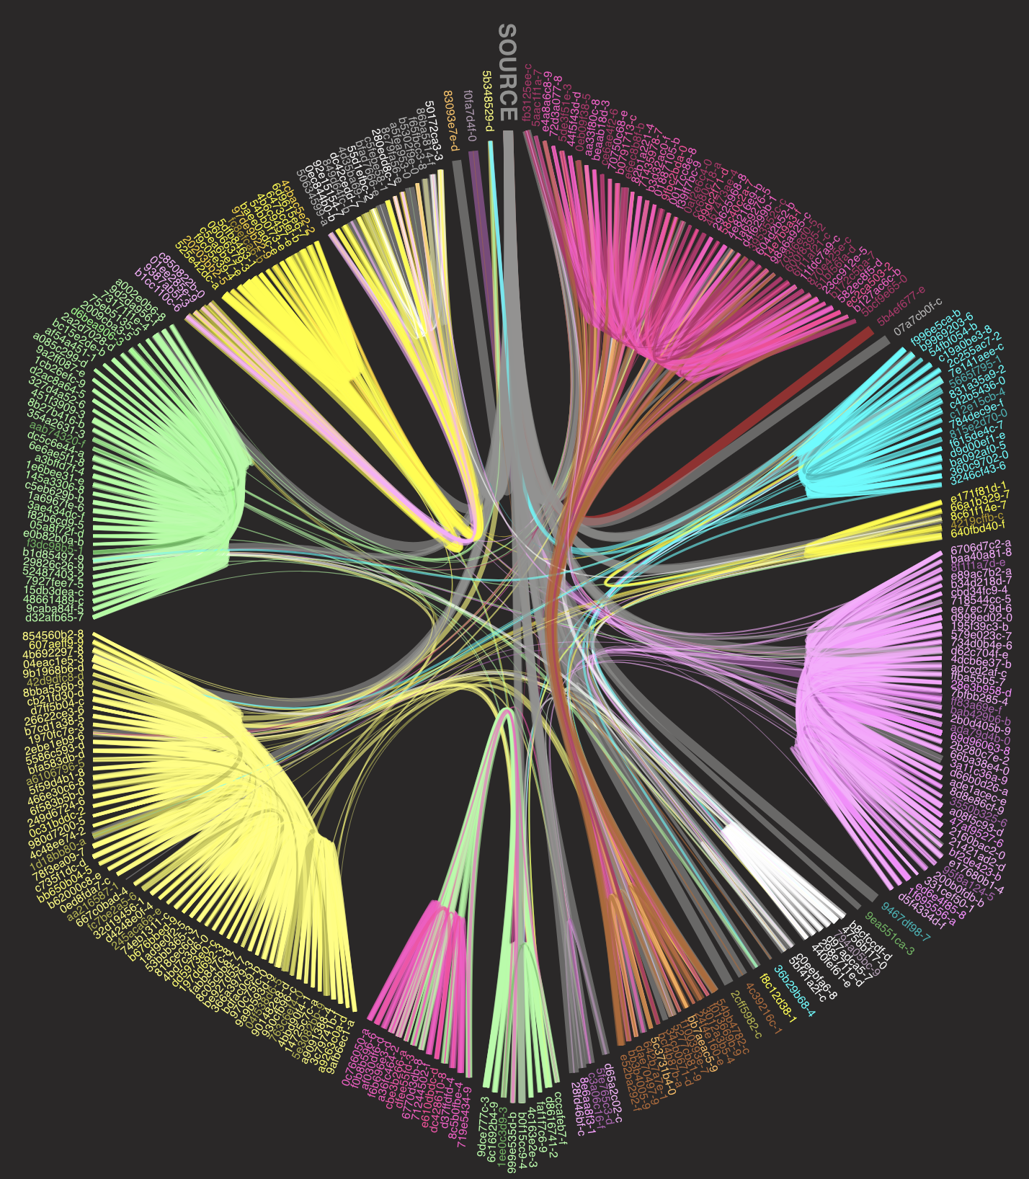
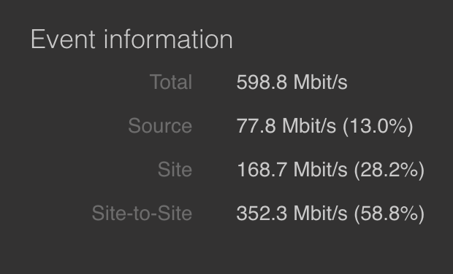
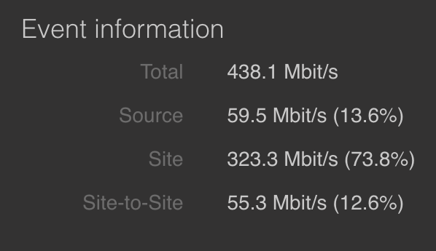
Predicting Local Edges

Slide 33
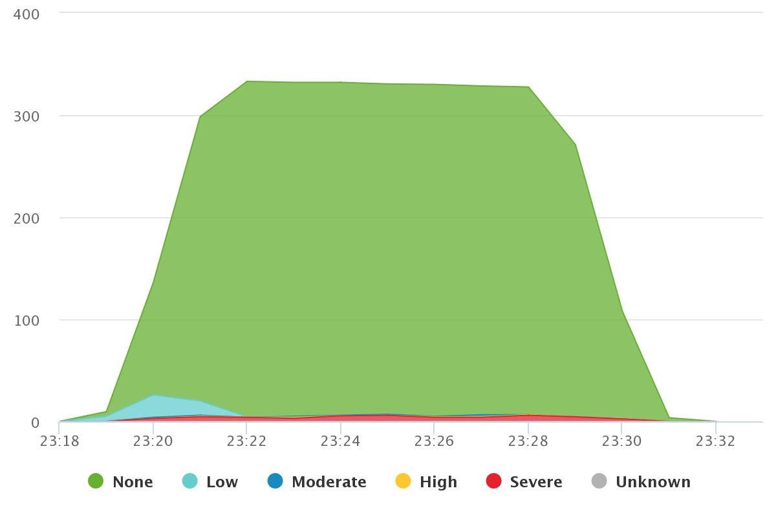
Predicting Local Edges
Problems?
Covers only 80% of our cases
Needs parameter tuning per customer

Slide 34

Conclusion

Slide 35
Thank you! Stefanos Antaris stefanos.antaris@hivestreaming.com antaris@kth.se

